Slide 1

How OpenChain ISO 5230 Works
Notes:
The OpenChain Project is here to help improve compliance processes and build trust across the supply chain.

Slide 2
OpenChain ISO 5230 defines the key requirements of a quality open source compliance program. The OpenChain Project develops this standard. Our vision is a supply chain where open source is delivered with trusted and consistent compliance information. Our mission is to establish requirements to achieve effective management of open source for software supply chain participants
Notes:
The most important point about how OpenChain is run related to who is running it. The project is run by user companies for user company. Everything we do is service to this and to the shared need for practical, real world solutions to address managing open source code.

Slide 3
OpenChain enables trusted and consistent compliance information in the supply chain
upstream
downstream
inbound
Open Source Compliance…
Program established
Tasks defined
Review and approval process
Compliance artifacts collected
Community engagement policy
outbound
Notes:
It defines the big picture, showing the inflection points where a company should have processes, policies or training.

Slide 4
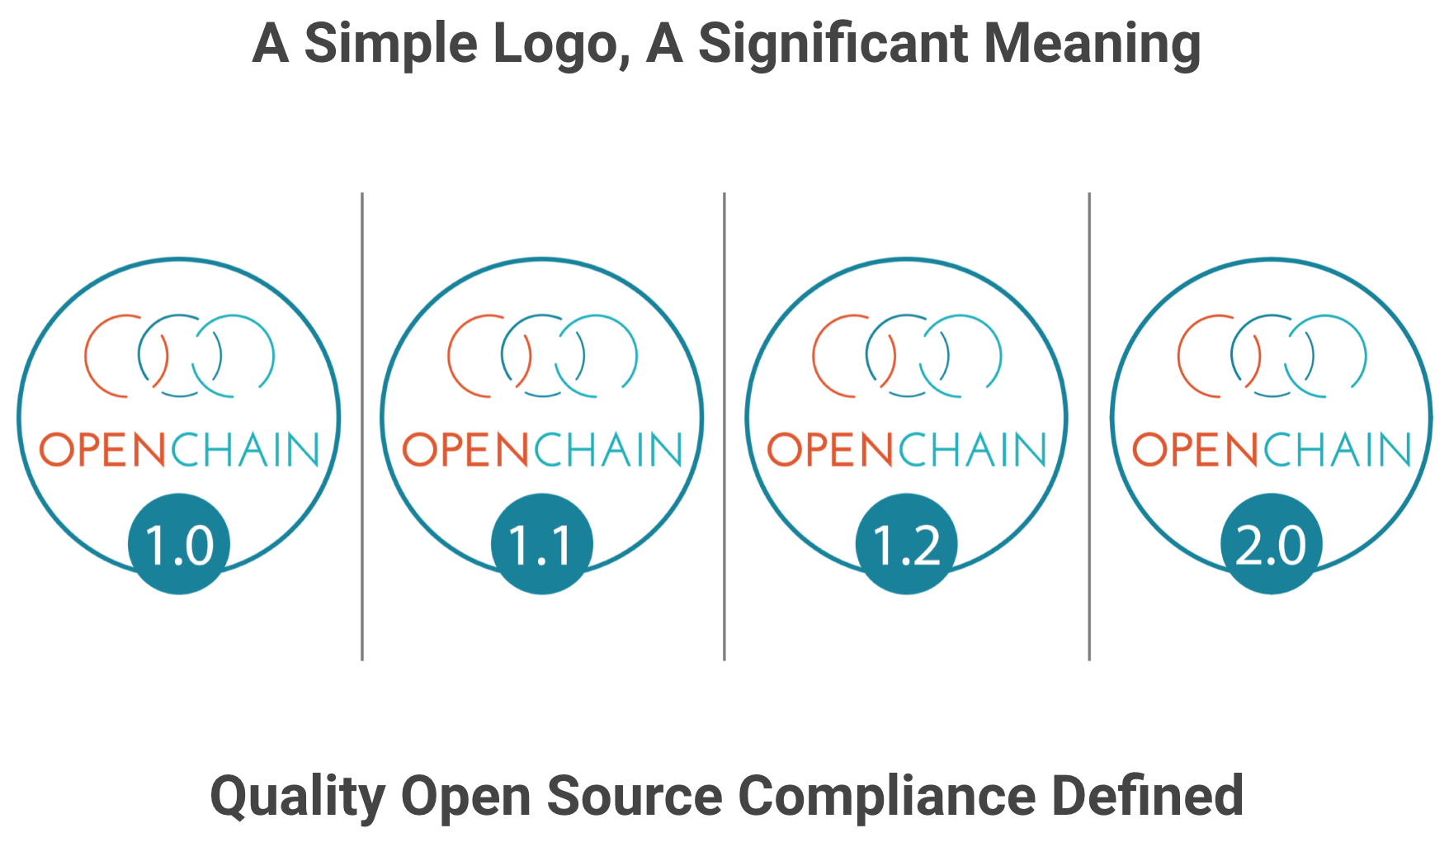
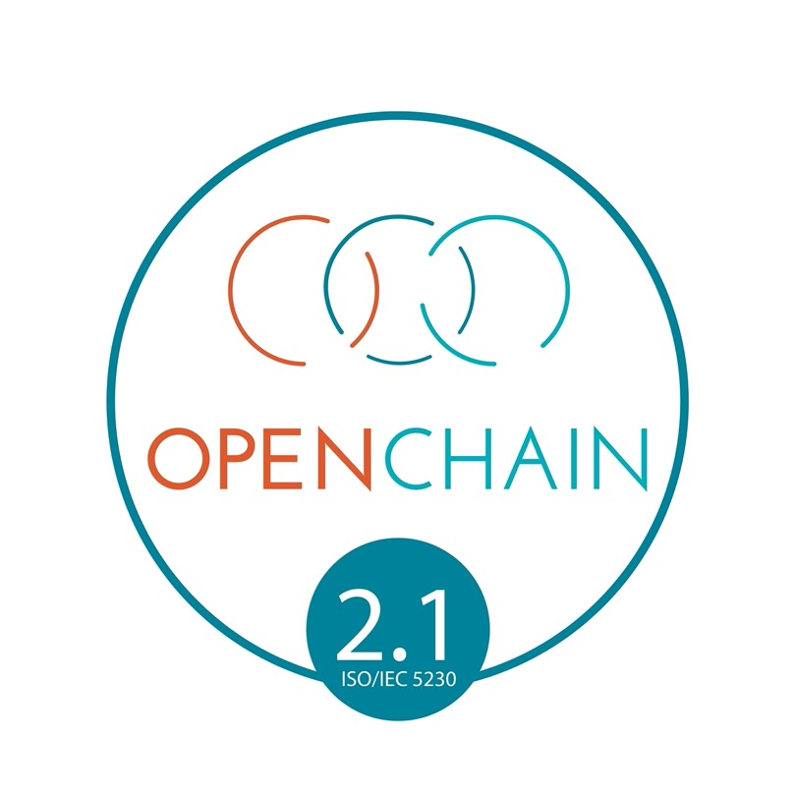
Notes:
Companies that meet the OpenChain Specification requirements can use a badge to identify their OpenChain Conformant program and the products that went through this program.

Slide 5

Notes:
Here are the current Platinum Member companies in the OpenChain Project.

Slide 6
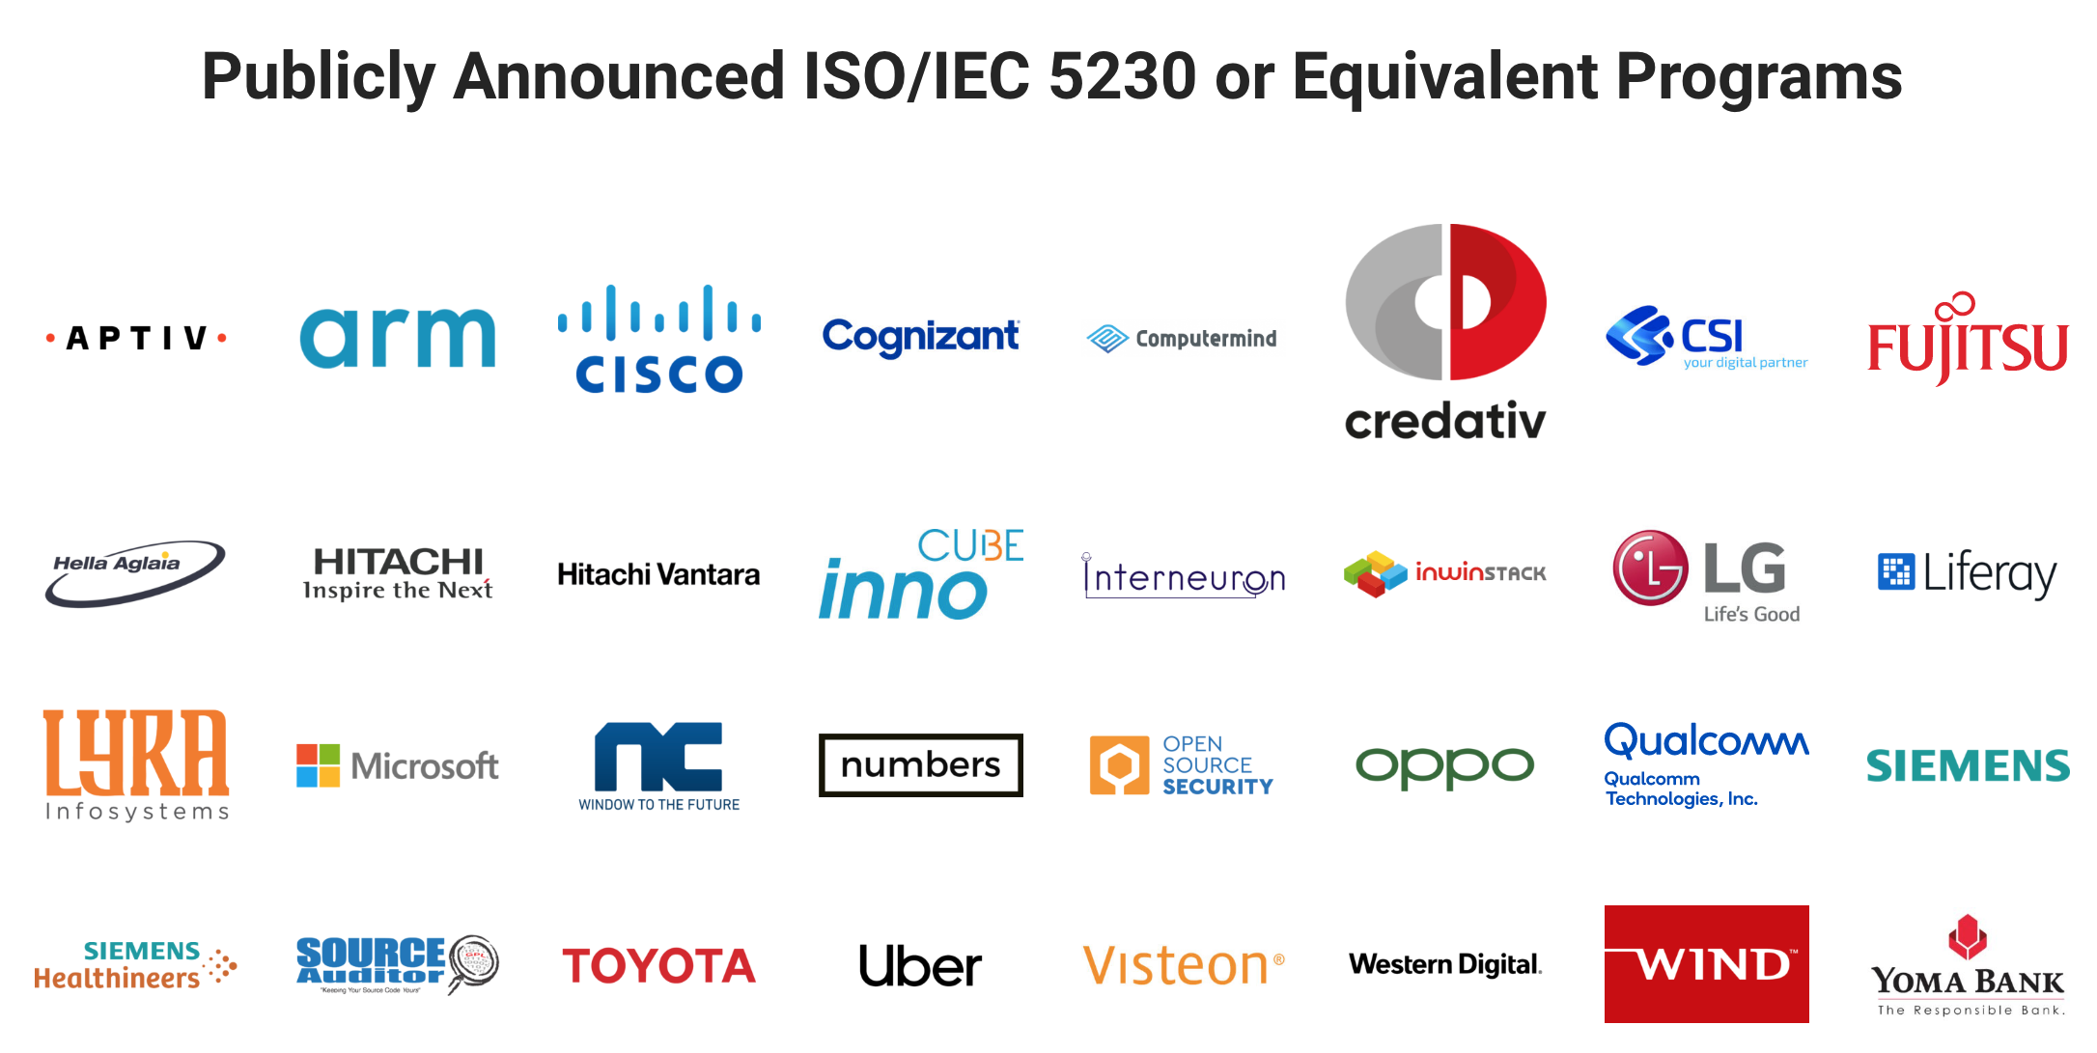
Notes:
There are a number of companies with a publicly announced OpenChain Conformant program that adheres to the requirements of ISO 5230. These companies come from a wide range of industries and represent a wide range of company sizes. Of course, there are many more undergoing OpenChain Conformance or without a publicly announced program.

Slide 7
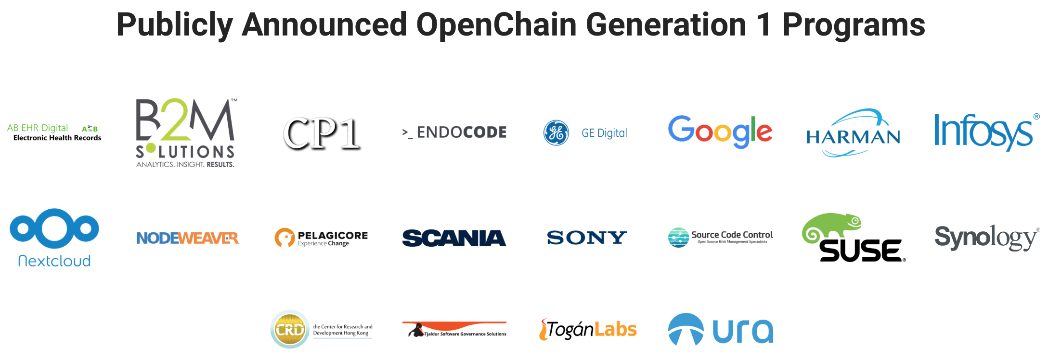
Notes:
There are a number of companies with a publicly announced OpenChain Conformant program related to the first generation of the OpenChain Specification. While not adhering to the specific terms of ISO 5230, these companies are in an excellent position regarding adoption.

Slide 8
Global + Local Communities
Global Mailing List
Global GitHub
Global Automotive
Global Education
Global Reference Tooling
China Work Group
Germany Work Group
India Work Group
Japan Work Group
Korea Work Group
Taiwan Work Group
UK Work Group
USA Work Group
Notes:
OpenChain has extensive local and global work groups actively support adoption with reference material and other community activities.

Slide 9
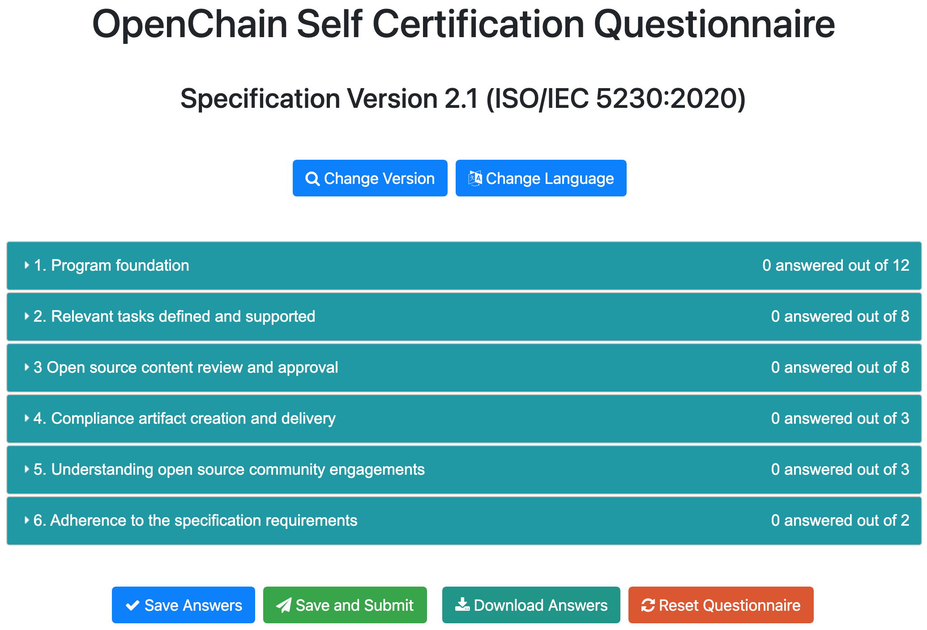
Notes:
We have a free self-certification web app with a responsive interface for computers, tablets and mobile phones. It is designed to allow any company in any market to quickly and easily conduct a private “compliance program health check” or to record conformance to the OpenChain Specification.

Slide 10

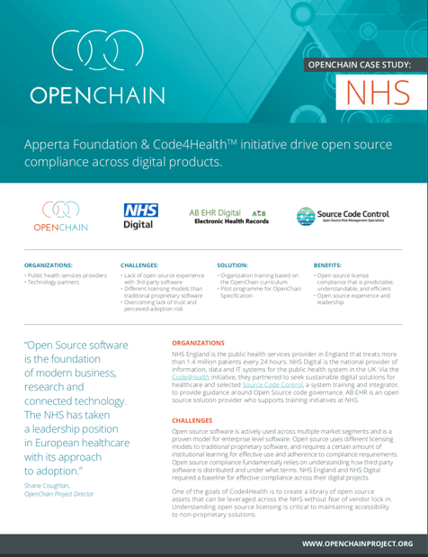
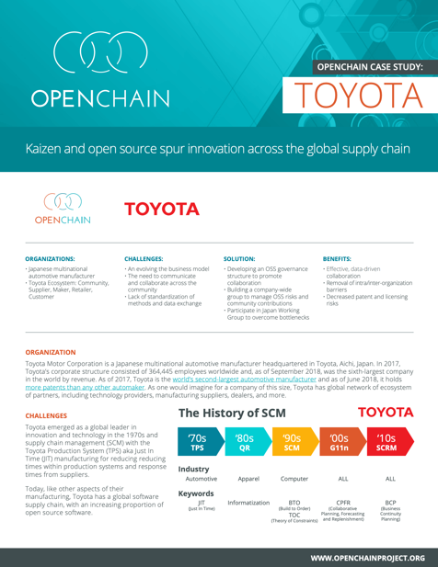
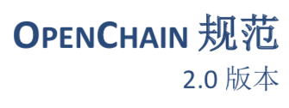
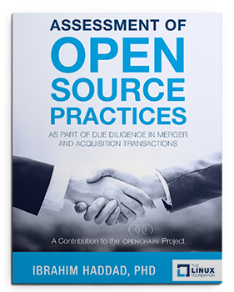

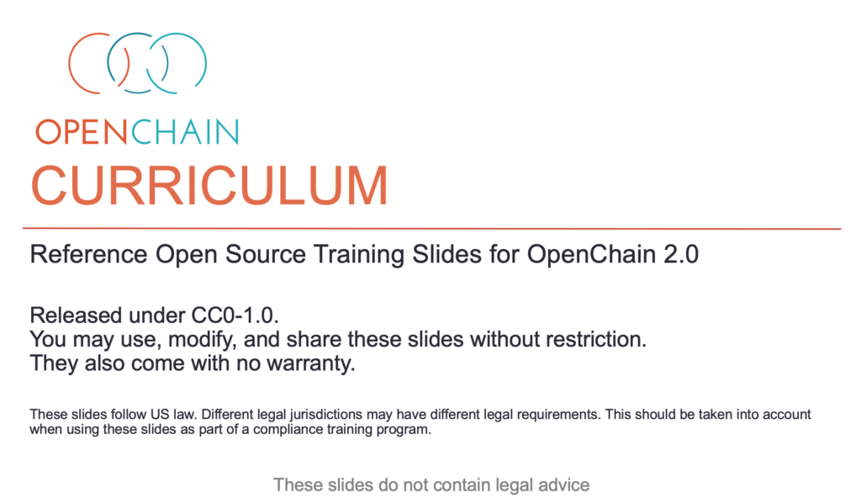
Comprehensive Reference Material
Notes:
We provide a wide range of reference materials and translations to assist with conformance.

Slide 11
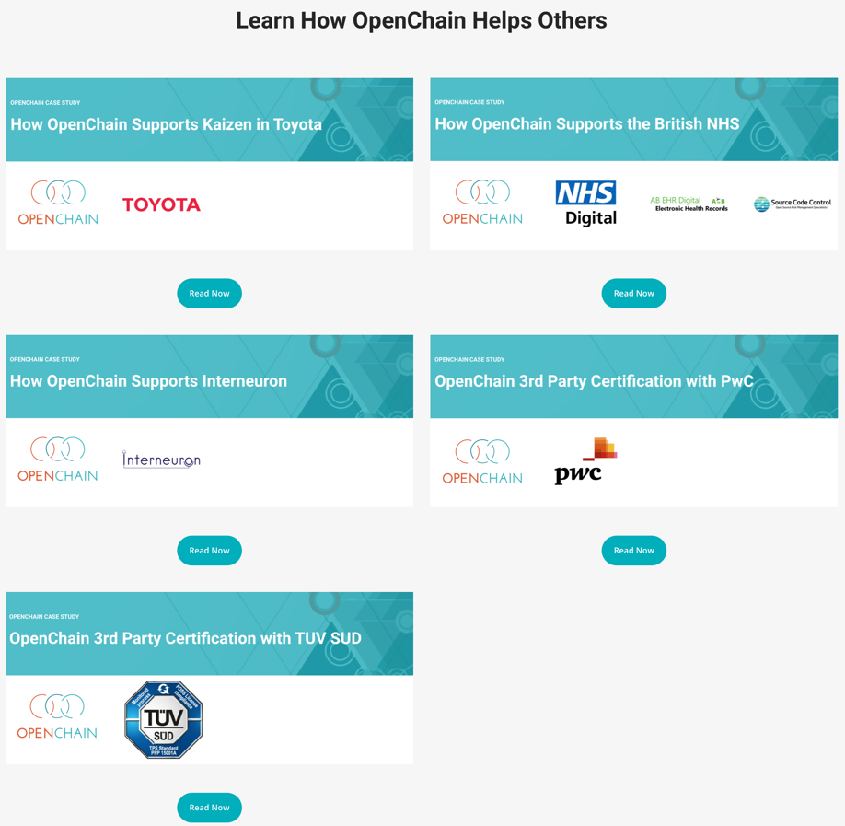
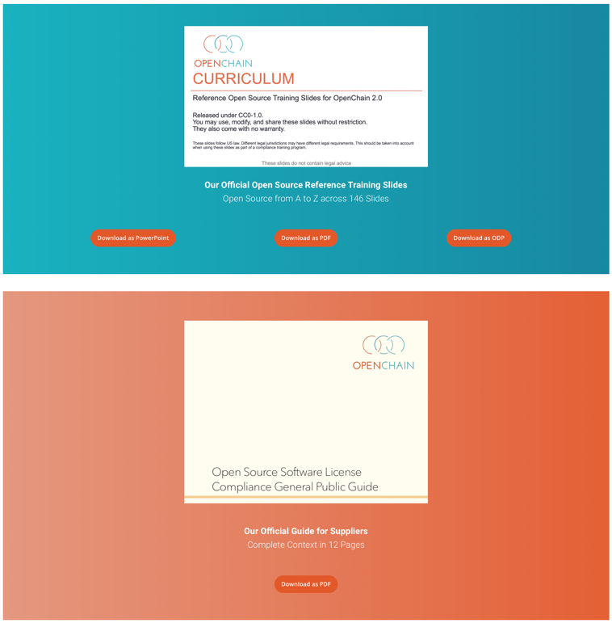
Notes:
The key reference items are provided directly on our website.

Slide 12
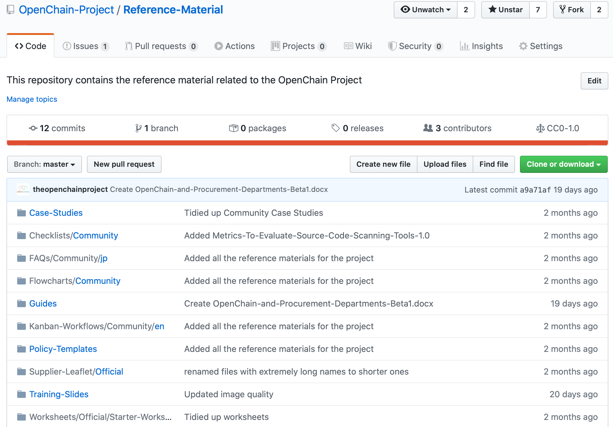
Notes:
A great deal of other information can be found on our GitHub repositories.

Slide 13
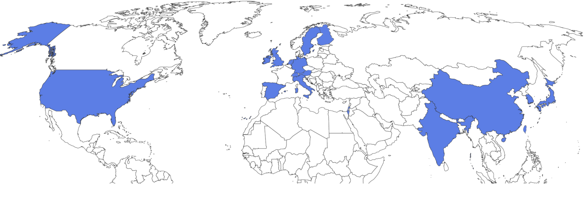
Partner Program – Global Physical Locations
Notes:
We have substantial and growing geographic coverage for the partner program. It now covers a significant number of strategic geographic locations, including the United States, China, South Korea, India, Japan, the UK, Germany, Italy, Spain, Sweden and Ireland.

Slide 14

Notes:
We have substantial and growing geographic coverage for the partner program. It now covers a significant number of strategic geographic locations, including the United States, China, South Korea, India, Japan, the UK, Germany, Italy, Spain, Sweden and Ireland.

Slide 15
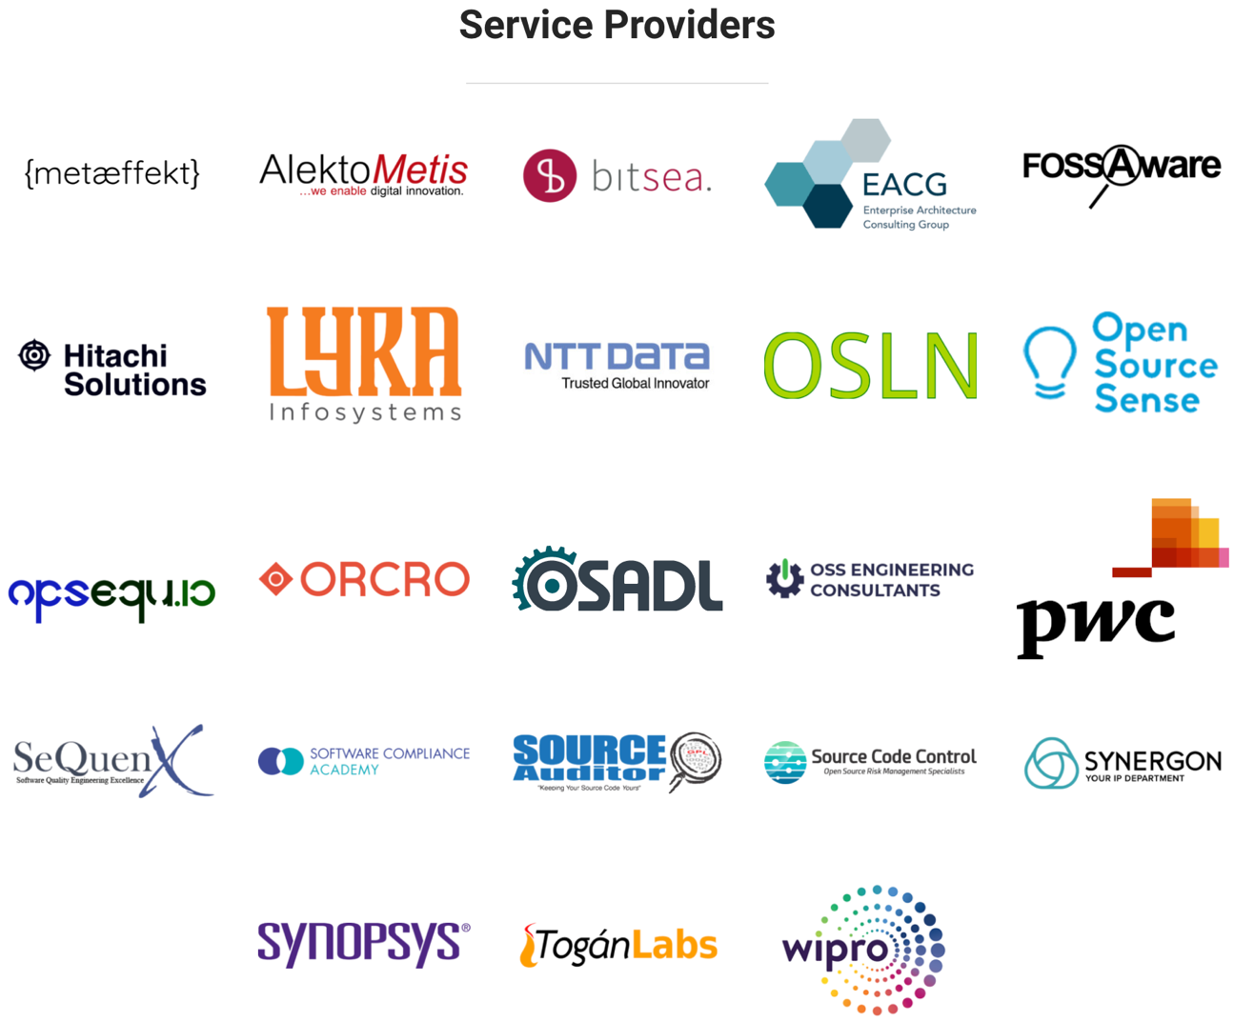
Notes:
We have substantial and growing geographic coverage for the partner program. It now covers a significant number of strategic geographic locations, including the United States, China, South Korea, India, Japan, the UK, Germany, Italy, Spain, Sweden and Ireland.

Slide 16

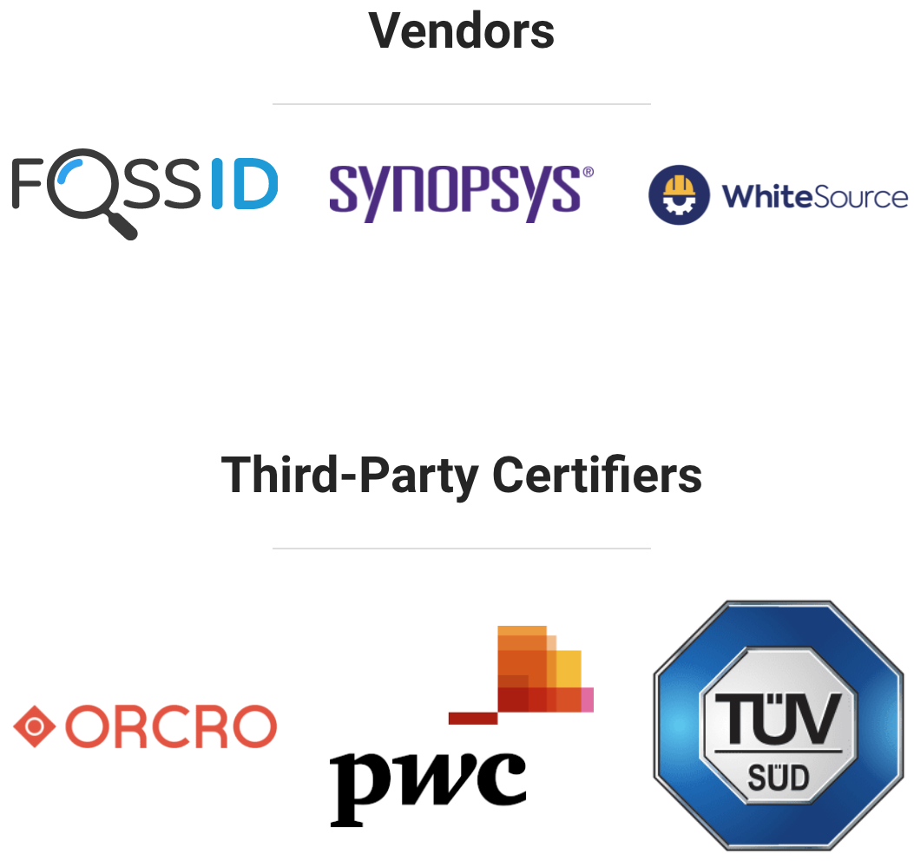
Notes:
We have substantial and growing geographic coverage for the partner program. It now covers a significant number of strategic geographic locations, including the United States, China, South Korea, India, Japan, the UK, Germany, Italy, Spain, Sweden and Ireland.

Slide 17

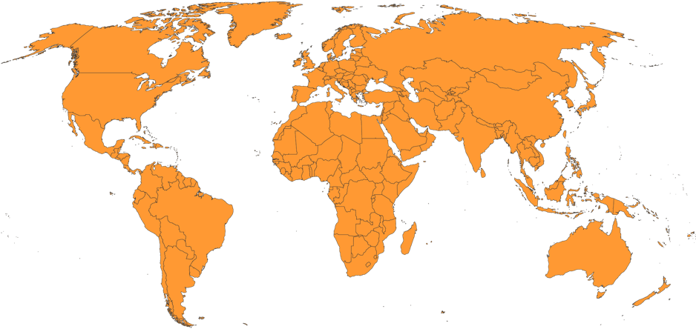
Notes:
TUV Sud and PwC both offer third party certification globally.

Slide 18
The OpenChain standard can be met by: Self-Certification Independent Compliance Assessment Third Party Certification
Freedom of Choice for Customers and Suppliers
Notes:
When it comes to meeting the OpenChain industry standard for open source compliance, we are fostering a diverse series of options for our diverse range of stakeholders, from self-certification to independent compliance assessments to third party certification.

Slide 19


OpenChain Frames Quality Compliance
Example Implementation Choices
Open Source Compliance Program…
Software Bill of Materials
Program established
Tasks defined
Review and approval process
Compliance artifacts collected
Community engagement policy
Automation to identify upstream, internal development and downstream open source software
The Projects And Tools Cited Are For Reference only. OpenChain ISO 5230:2020 is not prescriptive regarding process implementation choices.
Notes:
Compliance is core to effective strategic engagement with open source technology. It is very important that we can contextualize this effectively for our supply chains. There are various pre-existing industry standards to help contextualize solutions in this space (OpenChain and SPDX) and there is extensive tooling to support automation.

Slide 20
Self-Certification is at the heart of the OpenChain industry standard. Companies can access a series of yes/no questions to determine if they have implemented the key requirements of a quality open source compliance program. These questions can be found here: https://certification.openchainproject.org
Self-Certification
Notes:
Self-Certification is at the heart of the OpenChain industry standard. Companies can access a series of yes/no questions to determine if they have implemented the key requirements of a quality open source compliance program. These questions can be found here: https://certification.openchainproject.org

Slide 21
Independent Compliance Assessment is when an independent party such as a law firm, consultancy or accounting firm reviews the product of an OpenChain Self-Assessment and offers guidance on whether they perceive it as complete.
Independent Compliance Assessment
Notes:
Independent Compliance Assessment works in the same was as the Independent Security Assessment in ISO26262. An independent party such as a law firm, consultancy or accounting firm reviews the product of an OpenChain Self-Assessment and offers guidance on whether they perceive it as complete.

Slide 22
Third-Party Certification is a process whereby a certification body guides a company through an OpenChain ISO 5230 Conformance Process. The certification body then issues a formal conformance certificate. This activity maps precisely to the forms of third-party certification observed around automotive, infrastructure and similar fields and ISO standards.
Third-Party Certification
Notes:
Third-Party Certification is a process whereby a certification authority guides a company through an OpenChain Conformance Process. The certification authority then issues a formal certification document. This activity maps precisely to the forms of third-party certification observed around automotive, infrastructure and similar fields.

Slide 23
Get Started
Explore our community: https://www.openchainproject.org/get-started
Self-Certify or Health Check an organization: https://certification.openchainproject.org
Notes:
Please reach out to us if you have any comments, questions or ideas for participation and improvement.

